Slide 1
INHERITANCE
WITH SQL
Jose Annunziato

Slide 2
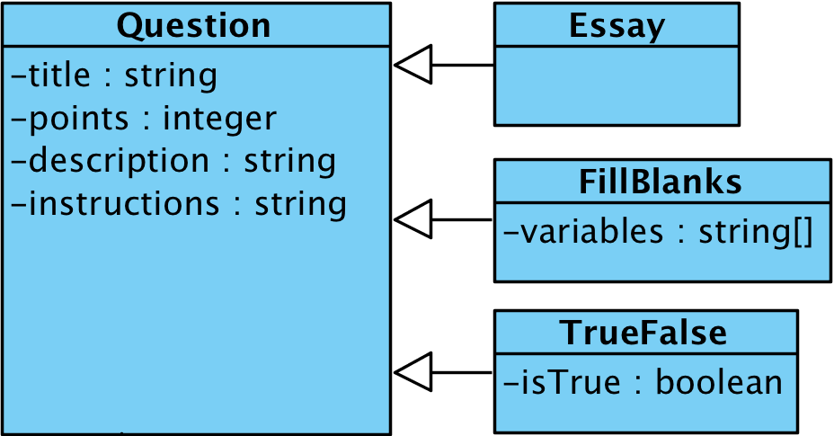

Slide 3
Modeling class inheritance in SQL
Many OOD concepts have no equivalence in relational databases, e.g., Inheritance
Even so, we can model the behavior
Three (3) inheritance strategies
Joined AKA Normalized
Single Table AKA Denormalized
Table per Class (Hybrid)

Slide 4
JOINED
(AKA NORMALIZED)
Jose Annunziato

Slide 5
joined_base_question
CREATE TABLE joined_base_question (
id int(11) NOT NULL AUTO_INCREMENT,
description varchar(255) DEFAULT NULL,
instructions varchar(255) DEFAULT NULL,
points int(11) NOT NULL,
title varchar(255) DEFAULT NULL,
PRIMARY KEY (id)
)

Slide 6
joined_true_false_question
CREATE TABLE joined_true_false_question (
id int(11) NOT NULL,
is_true tinyint(1) NOT NULL,
PRIMARY KEY (id)
FOREIGN KEY (id) REFERENCES
joined_base_question (id)
)

Slide 7
joined_fill_blanks_question
CREATE TABLE joined_fill_blanks_question (
id int(11) NOT NULL,
variables varchar(255) NOT NULL,
PRIMARY KEY (id)
FOREIGN KEY (id) REFERENCES
joined_base_question (id)
)

Slide 8
/inheritance/joined/base.json
{
"id": 1,
"points": 123,
"title": "title 123",
"description": "descriptions 123",
"instructions": "instructions 123"
}

Slide 9
/inheritance/joined/fill.json
{
"id": 1,
"points": 234,
"title": "title 234",
"description": "descriptions 234",
"instructions": "instructions 234",
"variables": "variables 234"
}

Slide 10
/inheritance/joined/true.json
{
"id": 1,
"points": 345,
"title": "title 345",
"description": "descriptions 345",
"instructions": "instructions 345",
"isTrue": true
}

Slide 11
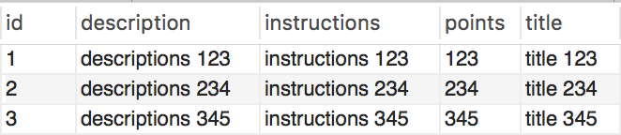
joined_base_question

Slide 12


joined_true_false_question
joined_fill_blanks_question

Slide 13
Retrieving a True False Question
SELECT title, points, description, instructions, is_true
FROM joined_base_question q,
joined_true_false_question tf
WHERE q.id = tf.id
AND q.id = 234;

Slide 14
Retrieving a Fill Blanks Question
SELECT title, points, description, instructions, variables
FROM joined_base_question q,
joined_fill_blanks_question fb
WHERE q.id = fb.id
AND q.id = 123;

Slide 15
Pros and Cons
Pros
Intuitive
Normalized
No redundancy → no inconsistency
Cons
Slow for long inheritance chains

Slide 16
SINGLE TABLE
(AKA DENORMALIZED)
Jose Annunziato

Slide 17
single_base_question
CREATE TABLE single_base_question (
dtype varchar(31) NOT NULL,
id int(11) NOT NULL AUTO_INCREMENT,
description varchar(255) DEFAULT NULL,
instructions varchar(255) DEFAULT NULL,
points int(11) NOT NULL,
title varchar(255) DEFAULT NULL,
variables varchar(255) DEFAULT NULL,
is_true bit(1) DEFAULT NULL,
PRIMARY KEY (id)
)
Only one table needed in single table strategy. All data is stored in one table. all fields in one table

Slide 18
/inheritance/single/base.json
{
"id": 1,
"points": 123,
"title": "title 123",
"description": "descriptions 123",
"instructions": "instructions 123"
}
responses are same as with joined strategy

Slide 19
/inheritance/single/fill.json
{
"id": 0,
"points": 234,
"title": "title 234",
"description": "descriptions 234",
"instructions": "instructions 234",
"variables": "variables 234"
}

Slide 20
/inheritance/single/true.json
{
"id": 0,
"points": 345,
"title": "title 345",
"description": "descriptions 345",
"instructions": "instructions 345",
"isTrue": true
}

Slide 21
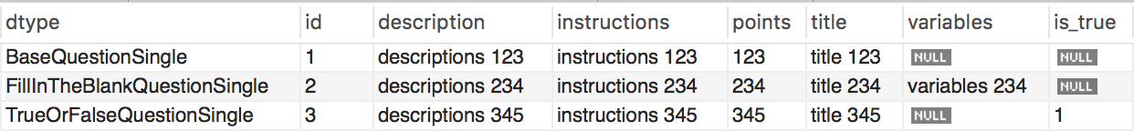
Retrieving a Question is Trivial / Fast
SELECT *
FROM single_base_question
WHERE id = 345;
;

Slide 22
TABLE PER CLASS
Dr. Jose Annunziato

Slide 23
Table Per Class Inheritance Strategy
Copies properties from classes higher in the inheritance chain to classes lower in the chain
Stores copies of data in multiple levels to avoid need to join multiple tables
Redundancy managed by application and/or libraries

Slide 24
per_class_base_question
CREATE TABLE per_class_base_question (
id int(11) NOT NULL,
description varchar(255) DEFAULT NULL,
instructions varchar(255) DEFAULT NULL,
points int(11) NOT NULL,
title varchar(255) DEFAULT NULL,
PRIMARY KEY (id)
)

Slide 25
joined_base_question
CREATE TABLE joined_base_question (
id int(11) NOT NULL AUTO_INCREMENT,
description varchar(255) DEFAULT NULL,
instructions varchar(255) DEFAULT NULL,
points int(11) NOT NULL,
title varchar(255) DEFAULT NULL,
PRIMARY KEY (id)
)

Slide 26
per_class_true_false_question
CREATE TABLE per_class_true_false_question (
id int(11) NOT NULL,
description varchar(255) DEFAULT NULL,
instructions varchar(255) DEFAULT NULL,
points int(11) NOT NULL,
title varchar(255) DEFAULT NULL,
is_true bit(1) NOT NULL,
PRIMARY KEY (id)
)

Slide 27
per_class_fill_blanks_question
CREATE TABLE per_class_fill_blanks_question (
id int(11) NOT NULL,
description varchar(255) DEFAULT NULL,
instructions varchar(255) DEFAULT NULL,
points int(11) NOT NULL,
title varchar(255) DEFAULT NULL,
variables varchar(255) NOT NULL,
PRIMARY KEY (id)
)

Slide 28
/inheritance/perclass/base.json
{
"id": 1,
"points": 123,
"title": "title 123",
"description": "descriptions 123",
"instructions": "instructions 123"
}
JSON is same as with joined strategy

Slide 29
/inheritance/perclass/fill.json
{
"id": 0,
"points": 234,
"title": "title 234",
"description": "descriptions 234",
"instructions": "instructions 234",
"variables": "variables 234"
}

Slide 30
/inheritance/perclass/true.json
{
"id": 0,
"points": 345,
"title": "title 345",
"description": "descriptions 345",
"instructions": "instructions 345",
"isTrue": true
}

Slide 31
PORTABLE ENUMS
Dr. Jose Annunziato

Slide 32
SQL Enum
Declares valid string values from list
CREATE TABLE sizes (
name ENUM('small','medium','large'));
If NOT NULL default value is first in list
Otherwise default is NULL

Slide 33
Portable Enums
Not all databases support enum keyword
Implement using tables/inserts
Consider following example
Movie
<<enumeration>>
Genre
genre : Genre
COMEDY
DRAMA
HORROR

Slide 34
Portable Enums
CREATE TABLE genre (
name varchar(20) NOT NULL,
PRIMARY KEY (name));
insert into genre(name) values ('COMEDY');
insert into genre(name) values ('DRAMA');
insert into genre(name) values ('HORROR');

Slide 35
Portable Enums
CREATE TABLE genre (
name varchar(20) NOT NULL,
PRIMARY KEY (name));
CREATE TABLE movie (
genre varchar(20), -- value must be in genre table
FOREIGN KEY -- behaves just like "enum"
(genre) REFERENCES genre (name));

